Slide 1
Reasoning with Preferences and Temporal Constraints: OPTIC

Slide 2
Relationships Between Planners
CRIKEY = FF + STN;
Colin = CRIKEY s/STN/LP/; (COLIN is clever as if you are in a planning problem or a state where you have not had any no continuous numeric change or a duration dependent effect [δx] it uses an STN which is more efficient, otherwise it uses an LP)
POPF = COLIN + Fewer ordering constraints;
OPTIC = POPF + Preferences.

Slide 3


Partial Order Planning Forwards: POPF
40
20
TD_{BED}
TA_{SAC}
TD_{SAC}
TA_{LON}
Move Train BED SAC
Move Train SAC LON
-ε
-40
-20
-ε
8:25
-ε
10
5
BD_{SAC}
Bus Route 1 SAC
Bus Route 2 CITY
BD_{DEP}
BA_{SAC}
BA_{CTY}
-10
-ε
-5
40
TD_{BED}
TA_{SAC}
-40
10
10
BD_{DEP}
BA_{SAC}
BD_{DEP}
BA_{SAC}
-10
-10
"Forward-Chaining Partial-Order Planning." A. J. Coles, A. I. Coles, M. Fox, and D. Long. ICAPS 2010
"Have I Been Here Before? State Memoisation in Temporal Planning" A. J. Coles and A. I. Coles. ICAPS 2016.

Slide 4
Optimising Preferences: OPTIC
40
20
TD_{BED}
TA_{SAC}
TD_{SAC}
TA_{LON}
-ε
-40
-20
-ε
-ε
P1
-ε
8:25
-ε
-ε
-ε
10
5
BD_{DEP}
BA_{SAC}
BD_{SAC}
BA_{CTY}
P2
-10
-ε
-5
-ε
35
The train and the bus are at the station simultaneously: (sometime (and (at train SAC) (at bus SAC)))
The bus arrives in the city at 9am or earlier: (within 35 (at bus CITY)))
" Searching for Good Solutions in Goal-Dense Search Spaces." A. J. Coles and A. I. Coles. ICAPS (2013)
"Temporal Planning with Preferences and Time-Dependent Continuous Costs." J. Benton, A. J. Coles and A. I. Coles. ICAPS (2012)
"LPRPG-P: Relaxed Plan Heuristics for Planning with Preferences.“ A. J. Coles and A. I. Coles. ICAPS (2011)

Slide 5
How Can we Encode this in the LP?
Train arrives before bus departs:
BD_{SAC} - TA_{SAC} >= 0.01
Bus arrives before train departs:
TD_{SAC} – BA_{SAC} >= 0.01
Bus arrives at CTY by 9am (time 35):
BA_{CTY} <= 35
But these are not hard constraints, if we put them in as such then the LP could become unsolvable and the plan can be reported as invalid when it is not.
Need to use a MIP (mixed integer program, aka, some of the variables are constrained to hold only integer values) and allow the option to veto the constraints.

Slide 6
Big M Constraints
We need:
An either 0 or 1 integer variable per each preference (p_{1 ,} p₂ in our case)
A very large constant M (arbitrarily bigger, just has to be much bigger than any durations).
Train arrives before bus departs:
BD_{SAC} - TA_{SAC} + Mp₁ >= 0.01
Bus arrives before train departs:
TD_{SAC} – BA_{SAC} + Mp₁ >= 0.01
Bus arrives at CTY by 9am (time 35):
BA_{CTY} - Mp₂ <= 35
In the objective function:
Minimise: whatever + 5 p₁ + 2 p₂
Now the MIP solver can choose either to make p1 = 0 (p2 = 0) and satisfy the constraints or make p1 = 1 (p2 = 1) and violate the constraint paying the objective cost.

Slide 7
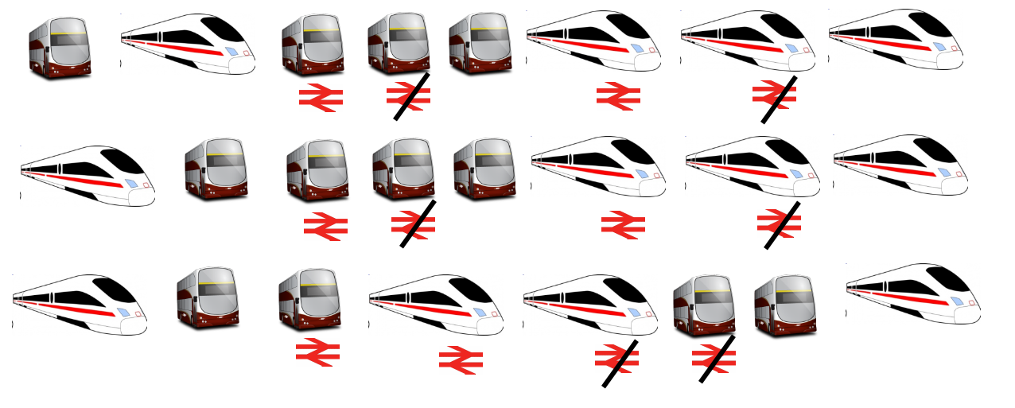
Synergy: Planner and Optimisation Solver
… 47 Combinations

Slide 8
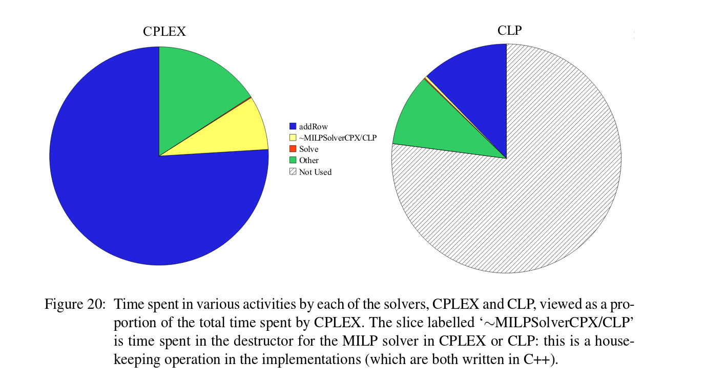
Now You’re Solving a MIP that could be NP Hard…
Again we tested it empirically, it’s not generally that time consuming, in fact surprisingly building the MIP takes longer than solving it:

